Slide 1
Happiness Analysis
Project 2 - Group 1

Slide 2
Project-2 Team members
Arisbel Batista
Sans Sharma
Tealiie Le
Kritika Chaudhary
Mehrdad Maleki
Kevin Swartz

Slide 3
Project objective:
Explore Happiness Scores and their relationship with other variables.
Deploy this information on an interactive dashboard.
https://happiness25.herokuapp.com/

Slide 4
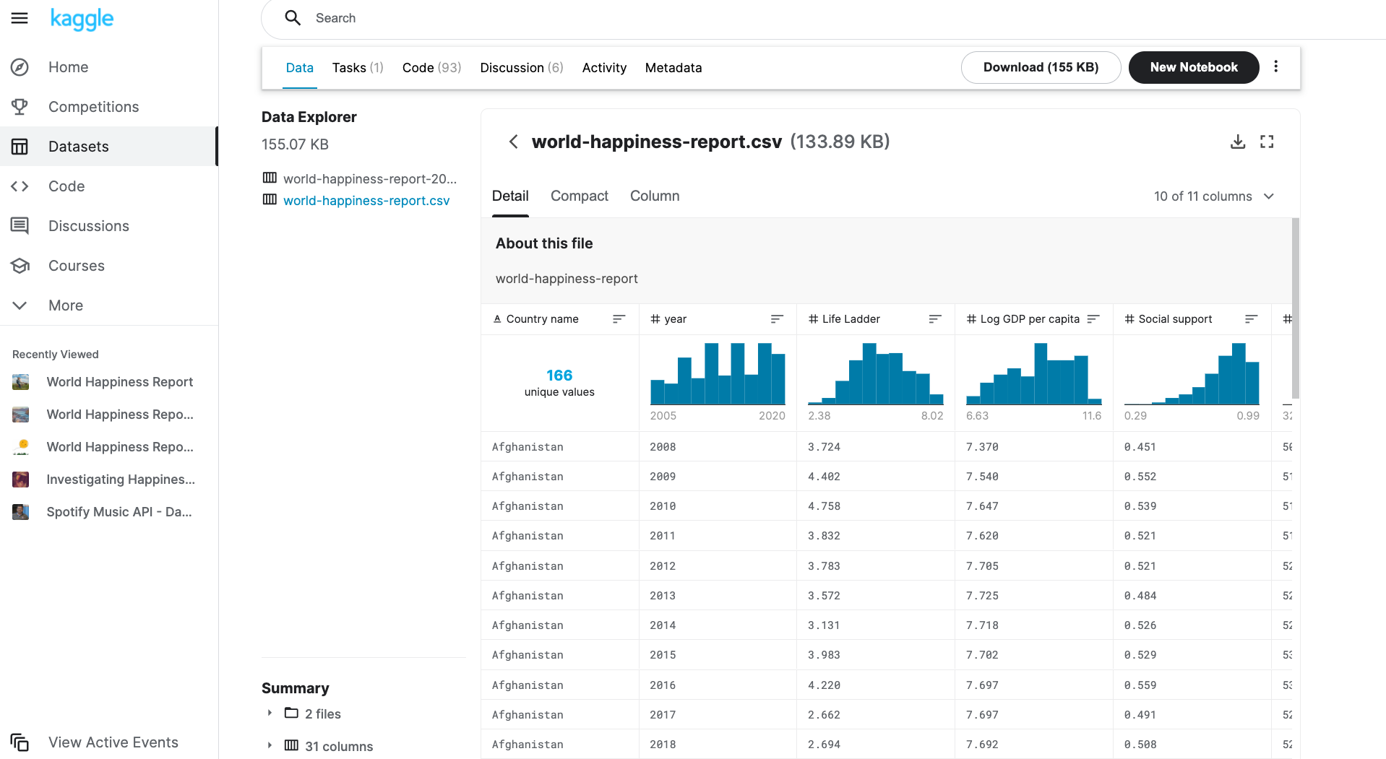
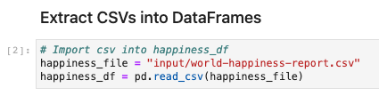
Data Extraction
Kaggle: csv file
Data per country
Happiness scores
GDP per capita
Life expectancy
Generosity
Freedom
Corruption
Years: 2009-2020

Slide 5
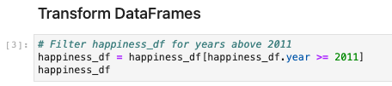
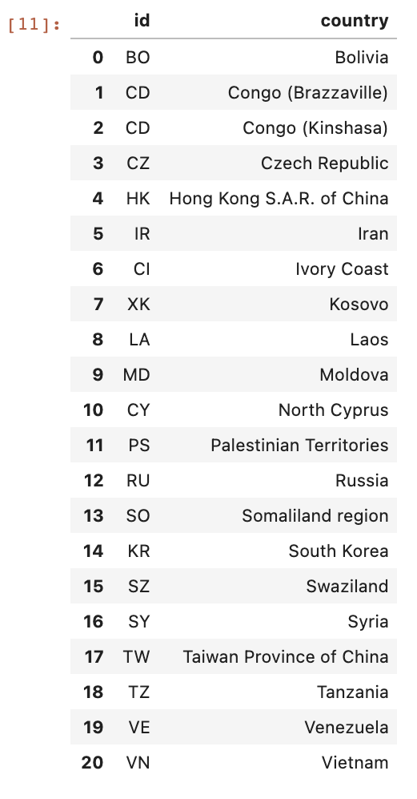
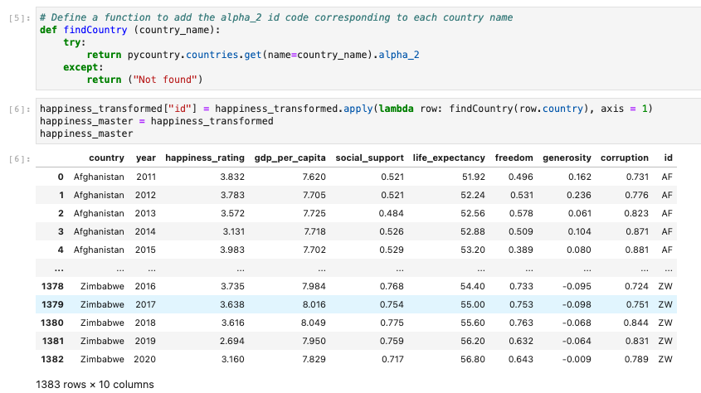
Data Transformation
Create a list of alpha_2 codes for Not Found countries
Filter years 2011-2020
Pycountry library to add alpha_2 country code

Slide 6
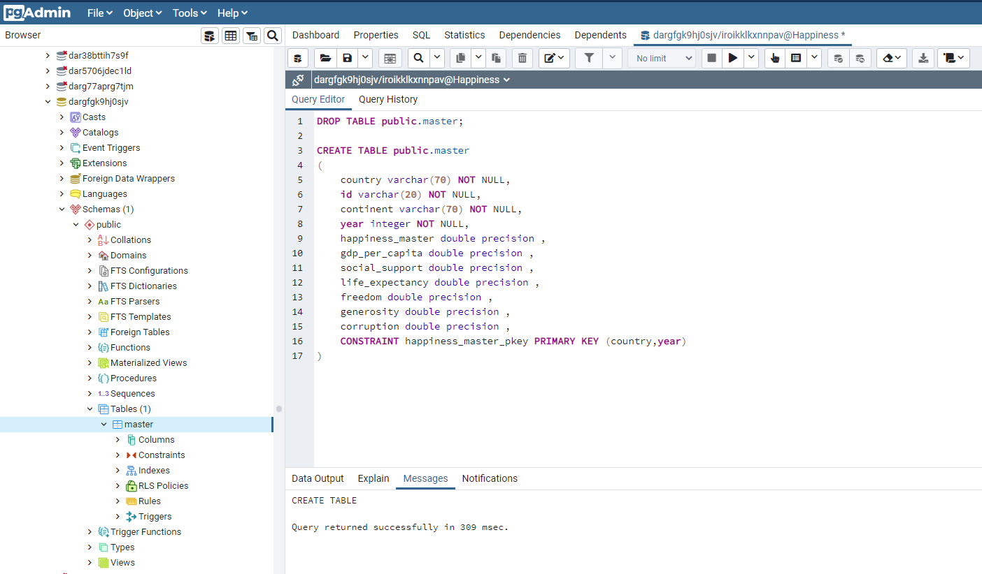
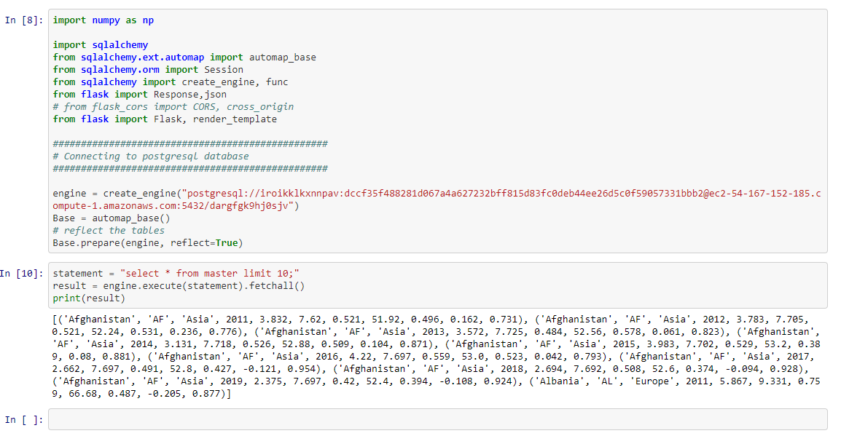
Data Loading

Slide 7
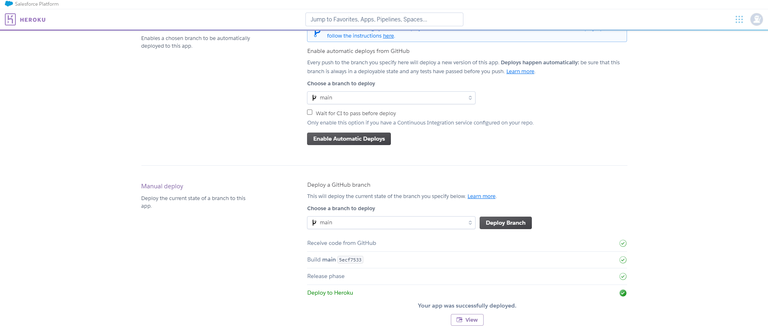
Deploying of Data

Slide 8
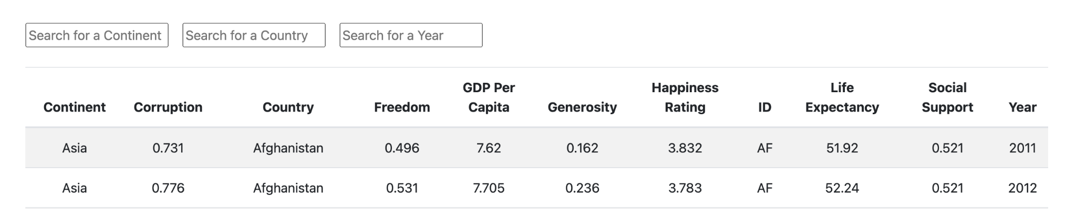
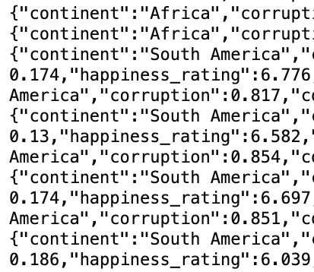
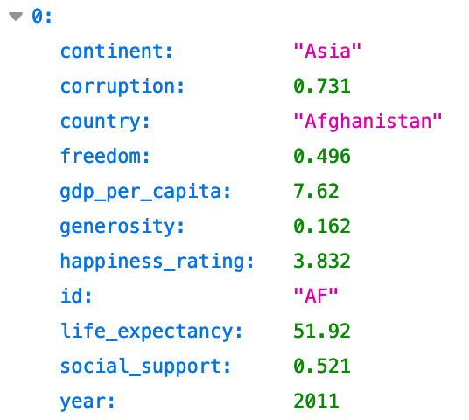
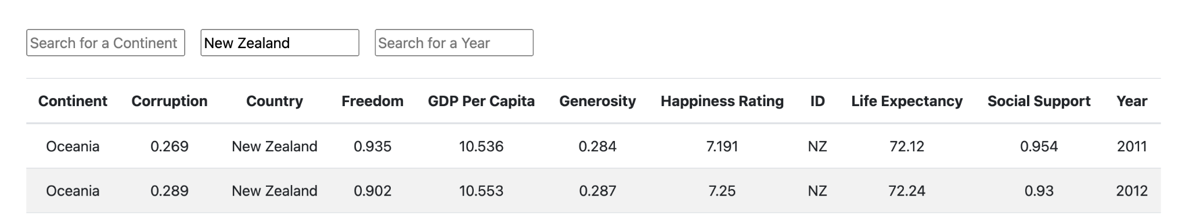
Data Table
Table format
Raw data format
Filter data to search specifics
JSON format

Slide 9
Happiness across the world
The ‘happiness scores’ are derived from self-reported statistics where people in over 150 countries rated their life satisfaction.
The world map visualization by year shows country-by-country the ‘happiness scores’ relative to GDP per capita.
Histogram frequency distribution across the world and per continent.
Scatter plots to assess relationship between variables.

Slide 10
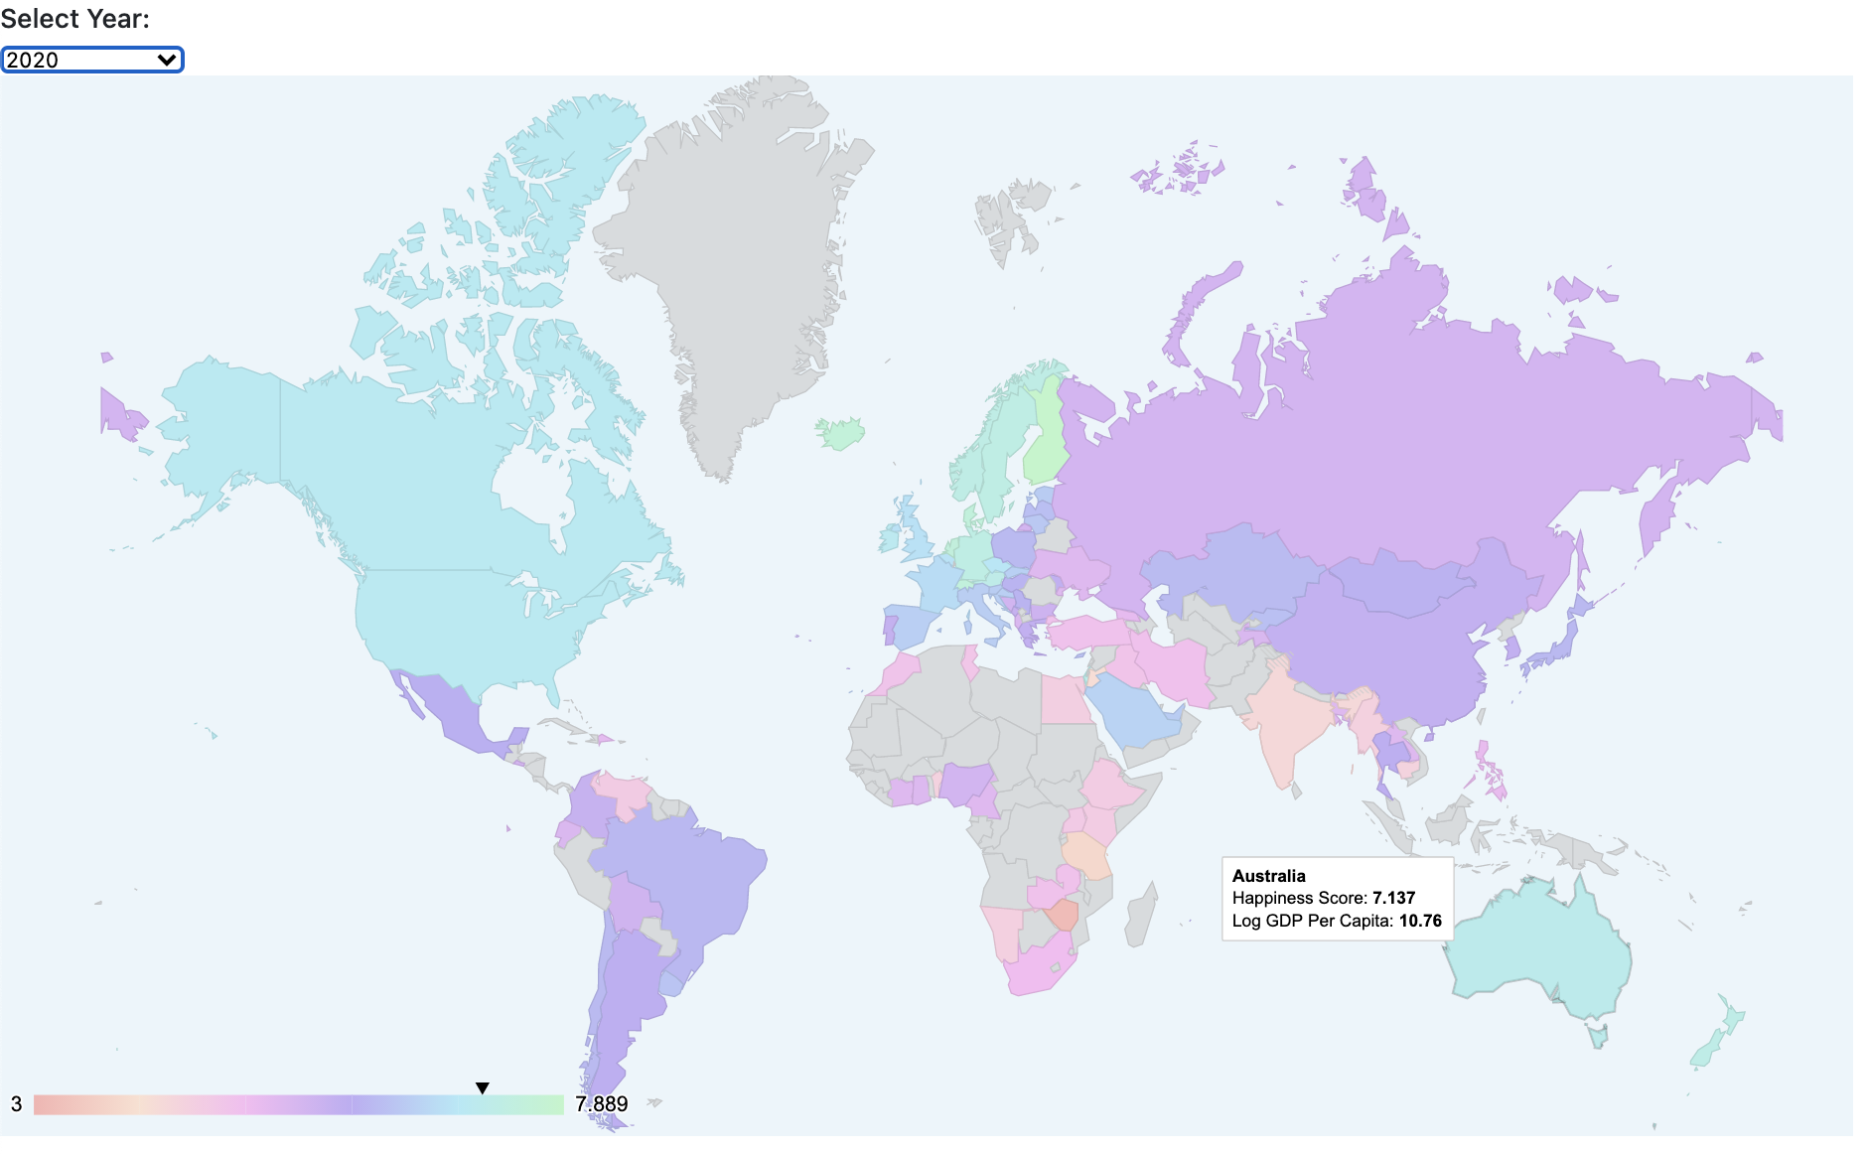
Map Chart
User interaction to filter map chart per year

Slide 11

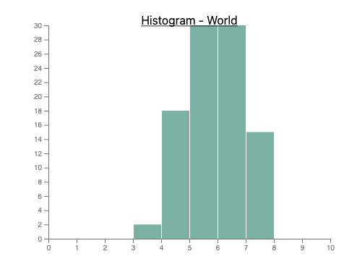
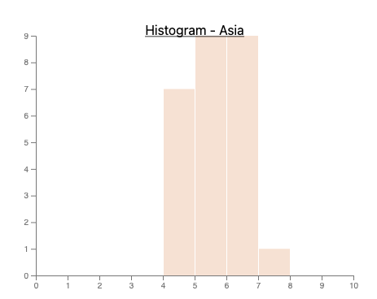
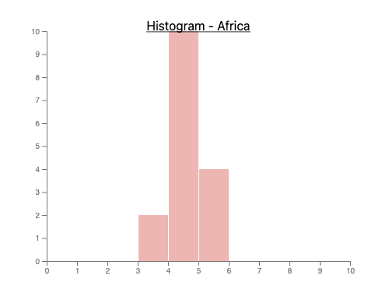
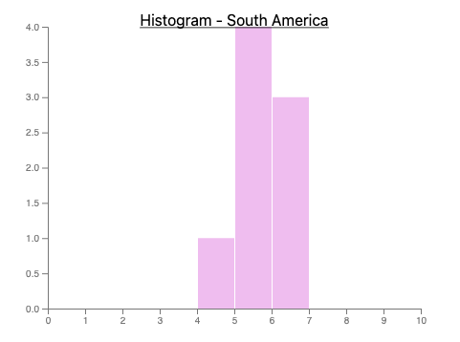
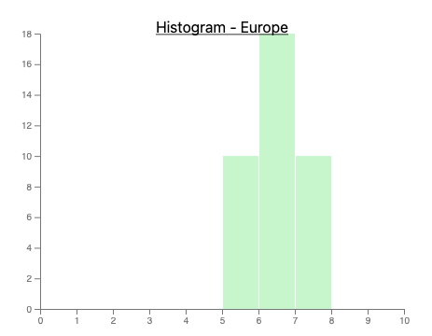
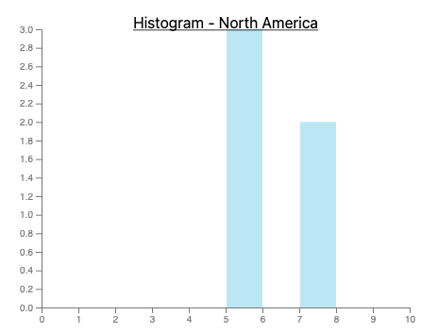
Histogram
User interaction to filter scatter chart per year

Slide 12
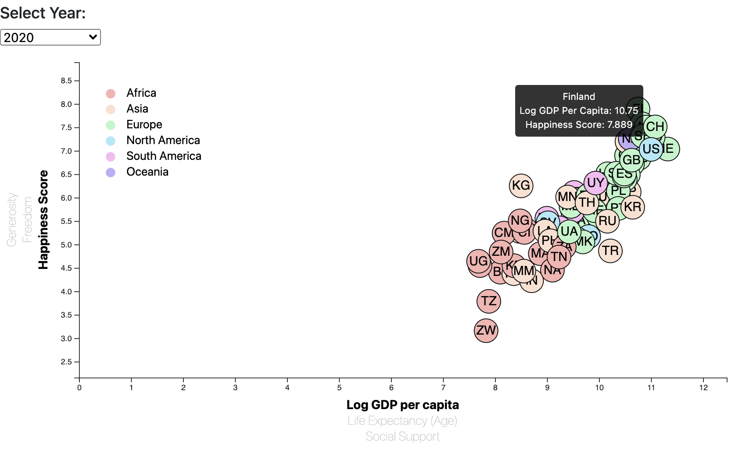
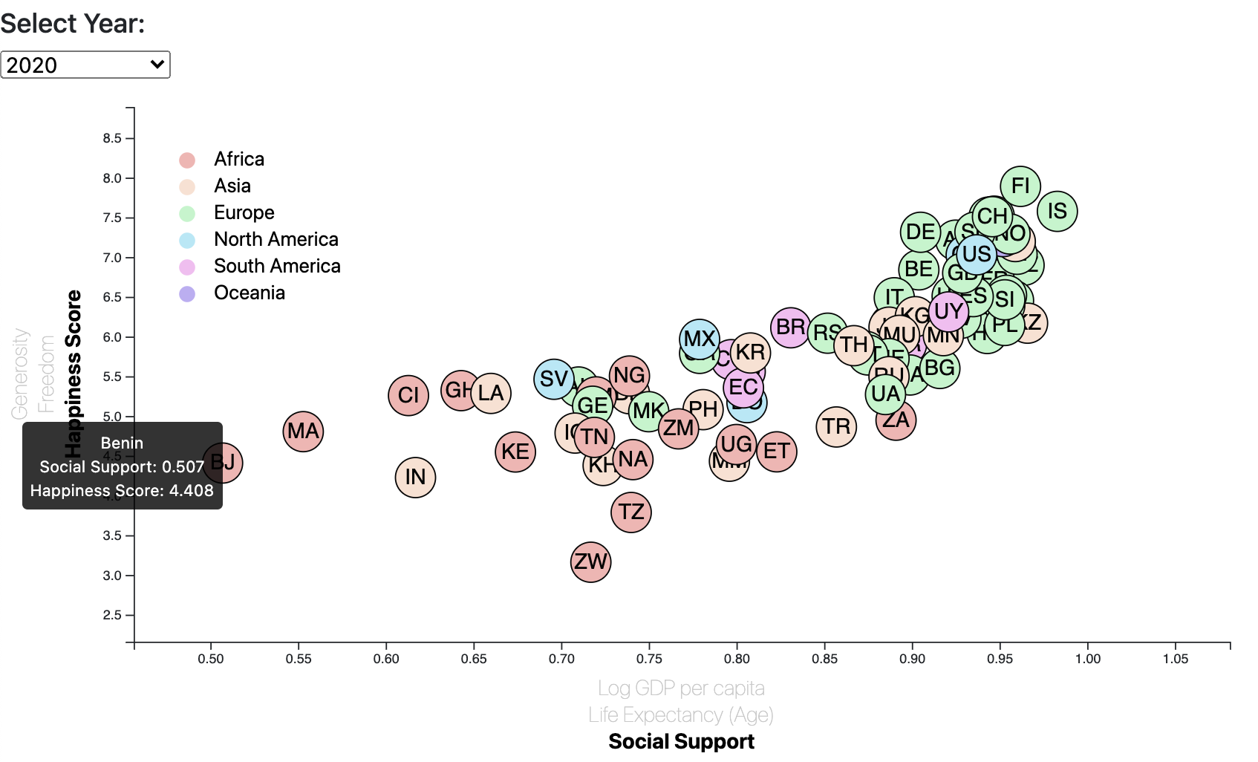
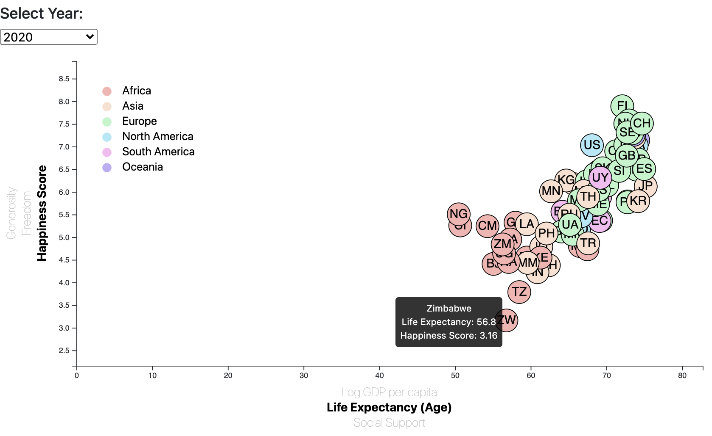
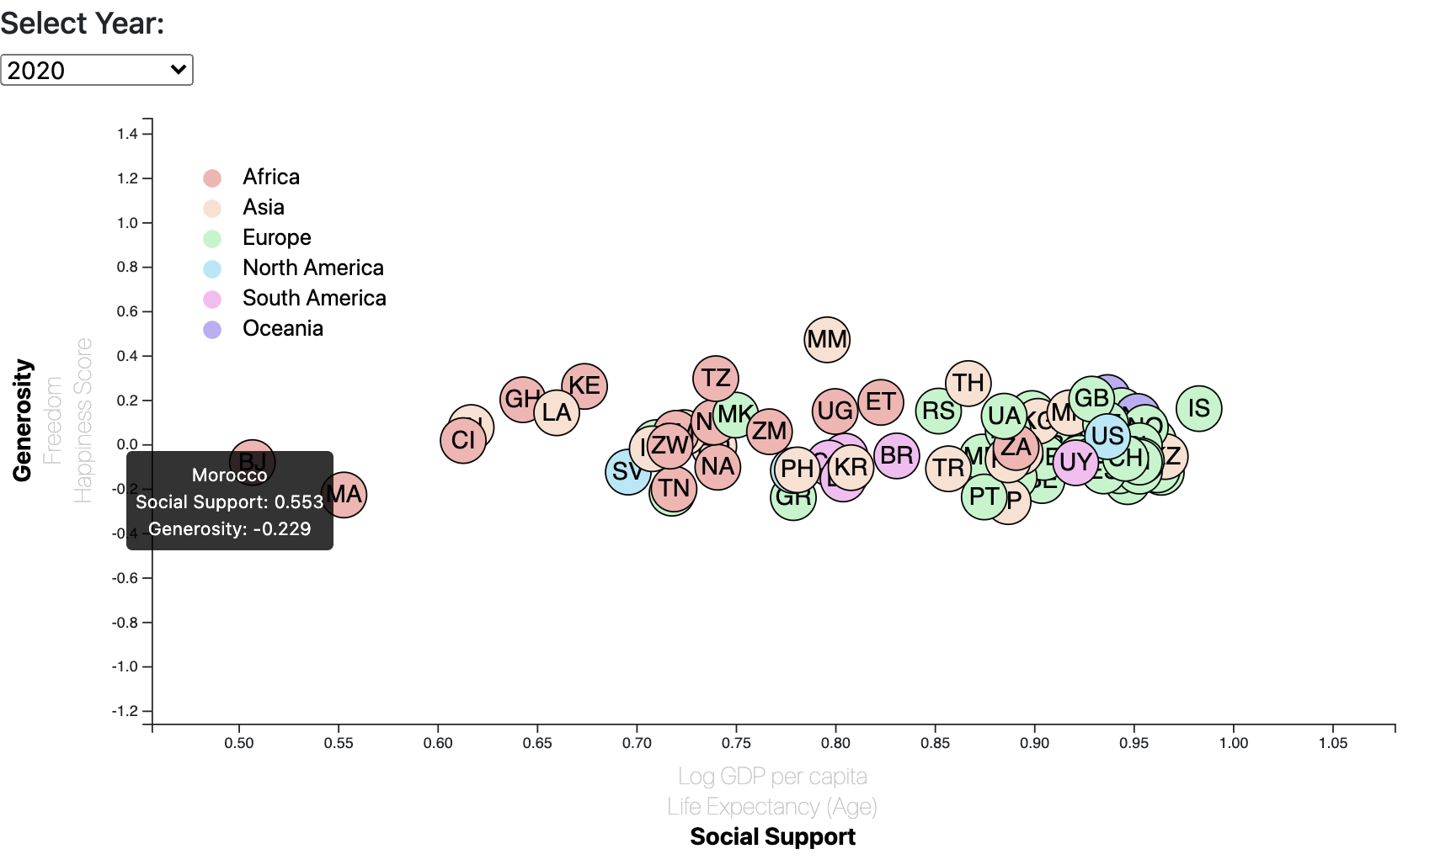
Scatter Chart
User interaction to filter scatter chart per year

Slide 13
Heroku Live Deployment
https://happiness25.herokuapp.com

